Slide 1
Mrs. Faulkner
Kindergarten Teacher

Slide 2
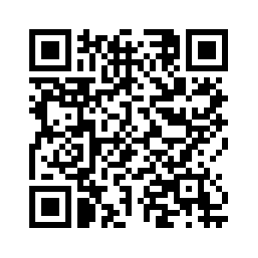
Mrs. Williams
Kindergarten Teacher

Slide 3
Mrs. Littlefield
Kindergarten Teacher

Slide 4
Mrs. Wroblewski
1st Grade Teacher

Slide 5
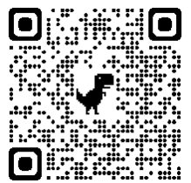
Mrs. Bunch
1st Grade Teacher

Slide 6
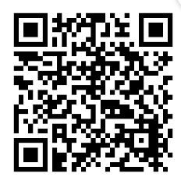
Mrs. Boldt
1st Grade Teacher

Slide 7
Mrs. Koontz
1st Grade Teacher

Slide 8
Mrs. McGhee
2nd Grade Teacher

Slide 9
Mrs. Hodge
2nd Grade Teacher

Slide 10
Mrs. King
2nd Grade Teacher

Slide 11
Mrs. Wilson
3rd Grade Teacher

Slide 12
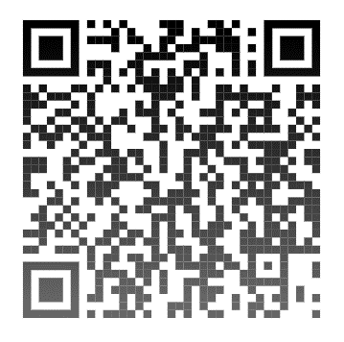
Mrs. Cohen
3rd Grade Teacher

Slide 13
Mrs. Fulton
3rd Grade Teacher

Slide 14
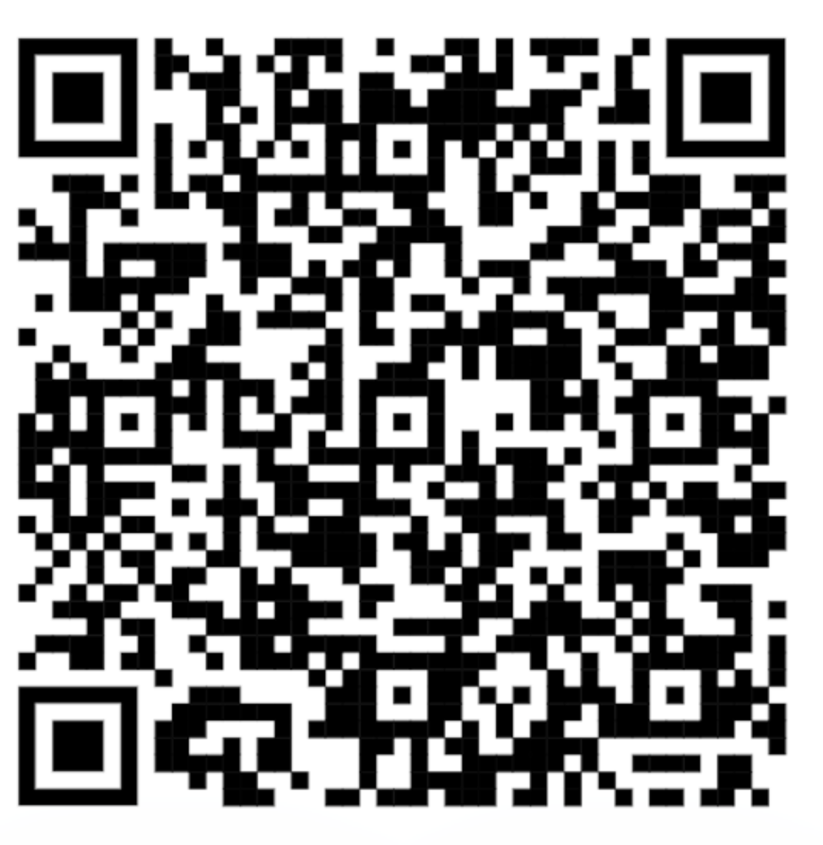
Mrs. Hite
3rd Grade Teacher

Slide 15
Mrs. Young
4th Grade Teacher

Slide 16
Mrs. Carter
4th Grade Teacher

Slide 17
Mrs. McCue
4th Grade Teacher

Slide 18
Mrs. Swilley
5th Grade Teacher

Slide 19
Mrs. Brazile
5th Grade Teacher

Slide 20
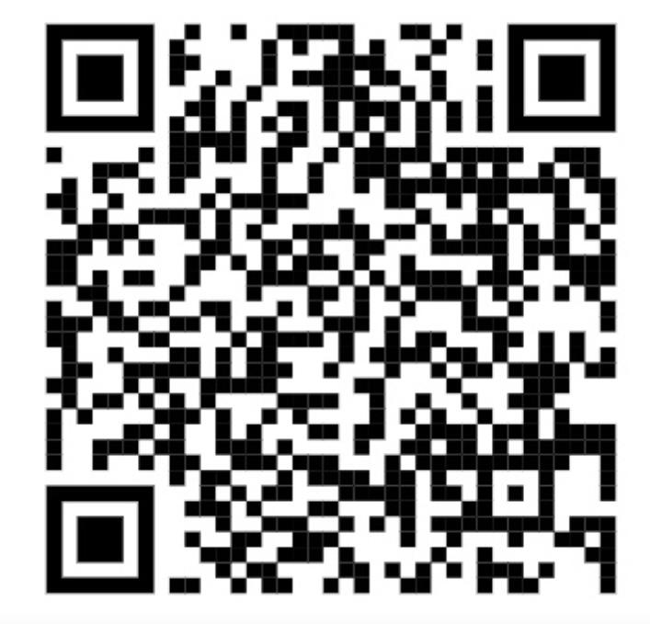
Mrs. Reinken
Librarian

Slide 21
Mrs. Saldahna
Art Teacher

Slide 22
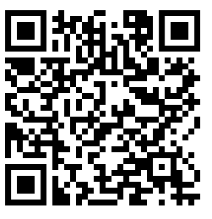
Mrs. Rodriguez
Gifted & Talented Teacher

Slide 23
Mrs. Rutherford
OSE Counselor

Slide 24
Nurse Annette
OSE Nurse

Slide 25
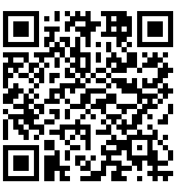
Mrs. Logue
Assistant Principal

Slide 26
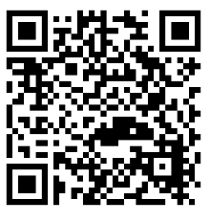
Mrs. Vlamakis
Office Staff

Slide 27
Mrs. Smith
Office Staff

Slide 28
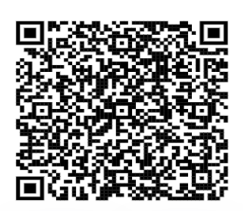
Mrs. Neetz
Office Staff

Slide 29
Mrs. Allen
To include the Special Education & Paraprofessional’s

Slide 30
Mrs. Browne
Special Education Teacher

Slide 31
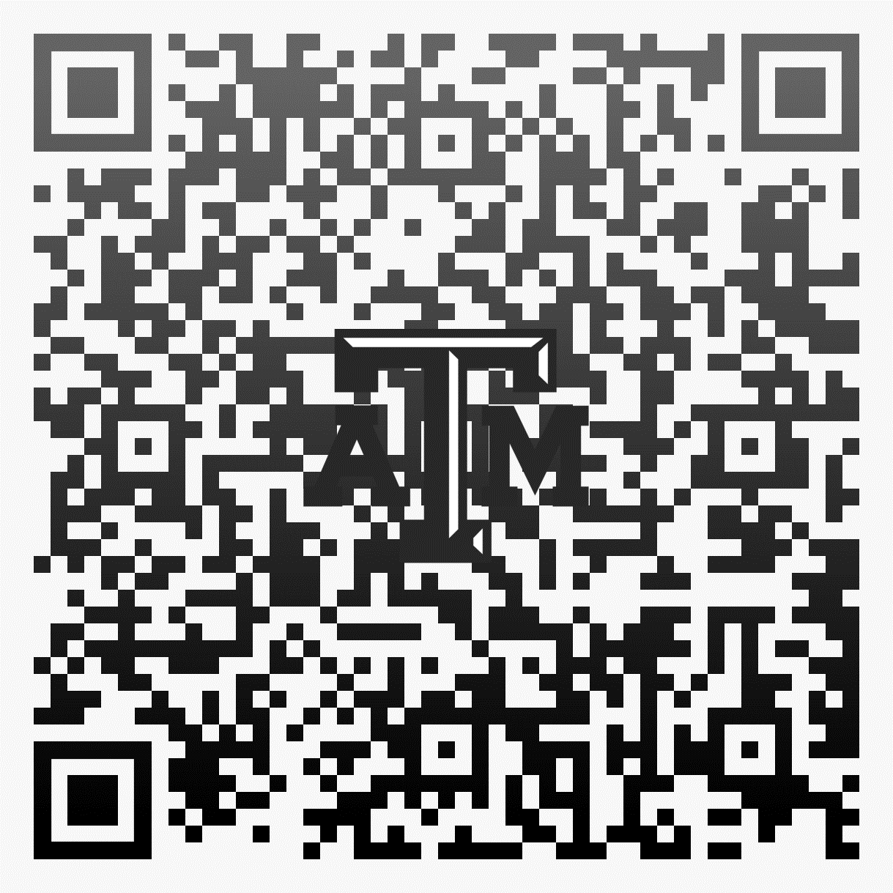
Mrs. Brock
Specially Designed Instruction

Slide 32
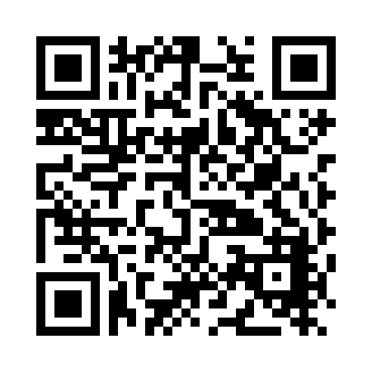
Mrs. Nelson

Slide 33
Mrs. Park

Slide 34
Mrs. Toeniskoetter

Slide 35
Mrs. Vrenios

Slide 36
Mrs. Singh

